Slide 1
REACT: Basic Concepts
DigiGirls: Salt Lake City

Slide 2
Before we begin…
NPM: Node Package Manager
This is where to go to download any package for node.
A “package” is a code package- it could be a project template or something that’s complete and working end-to-end.
Most packages are obtained by npm install PACKAGE
Most packages can be run with NPM start

Slide 3
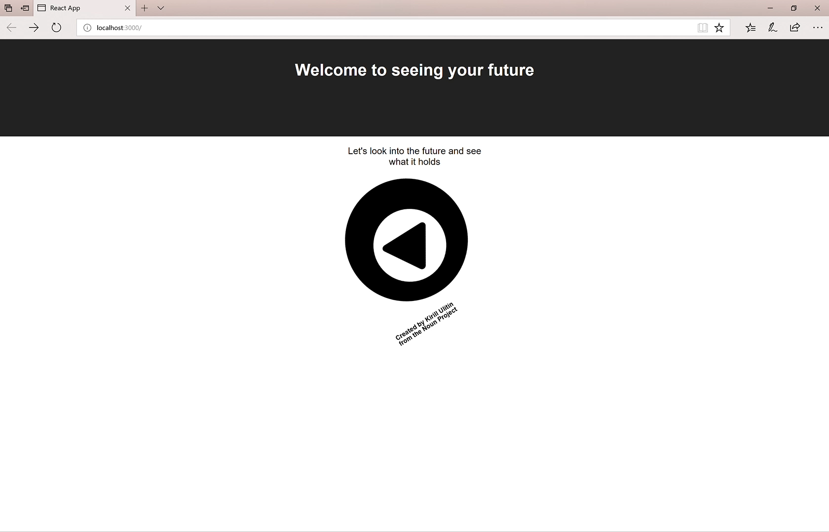
So… what are we gonna do for the next hour?
Build a webpage together- not just any webpage, one that can see the future!

Slide 4
How many of you have built a webpage before?

Slide 5
HTML: Hyper Text Media Language
How you tell a web site what to render (or draw) for you.
Opening tags <div> (divider)
Closing tags </div>
Same line <img src=“image.jpg” />

Slide 6
CSS: Cascading Style Sheets
A way to apply styles like background colors to your text/web page
There are “classes” that you categorize your HTML
Changes font color: color: white
Changes background color: background-color: #222;
Sets height/width of objects:
height: auto;
width: auto;
max-width: 300px;
max-height: 300px;
Can also set animations! (advanced): animation: image-spin infinite 20s linear;

Slide 7
Components
Every piece of a page in your project can be classified as a “component”- in REACT, components work together to make pages.
We will be making THREE components together:
An “App” component
A “Magic-Eightball component
A “Fortune” component

Slide 8
Let’s get started!
First, let’s install the basic outline of our code first.
Open up a cmd prompt and run
“npm install Digigirlz-React-Starter-Demo”
Once that’s installed, run “npm run start”
What do you see?

Slide 9
Let’s add some content!
Right now our futures are pretty empty, let’s start by putting in a magic eight ball there to read our future!
const magicEightBall = require('../images/Magic_eight_ball.png');
Now let’s add our magic eight ball!
<img src={magicEightBall} className="Magic-Eightball-Image" />

Slide 10
How do we get our fortune?
First, lets make a fortune component
Under components, lets create a blank component call “Fortune.tsx”.
For now, lets just copy our magic eight ball and rename it “Fortune”
class MagicEightBall FortunePage extends React.Component {
export default MagicEightBall Fortune;

Slide 11
Now let’s make it so we can “Route” to our fortune!
On our App.tsx lets add a new “Route” to our switch
<Route path="/fortune" component={FortunePage}/>
Now, let’s make our magic eight ball “Link” to our fortune!
<Link to="/fortune">
<img src={magicEightBall} className="Magic-Eightball-Image" />
</Link>
Lets change our magic eight ball so it’s something different
render() {
return (
<div> Your fortune is: You are Awesome!<div>
</div>
);

Slide 12
Try it out!
This is a pretty boring fortune, let’s generate some fortunes…
You’ll notice a common file, let’s import it!
import * as Common from '../common’;
Wait what did we just do?
Get an “Enum” called FortuneType:
export enum FortuneType {
Good,
Bad,
Neutral
}
Get an “Interface” called Fortune
export interface Fortune {
fortuneType: FortuneType;
fortune: string;
}

Slide 13
Okay, NOW let’s generate some fortunes
let fortunes: Common.Fortune[] = [
{fortuneType: Common.FortuneType.Good, fortune: 'You will make a lot of money'},
{fortuneType: Common.FortuneType.Good, fortune: 'You will get into the college of your dreams'},
{fortuneType: Common.FortuneType.Good, fortune: 'You\'ll stumble upon a lost object'},
{fortuneType: Common.FortuneType.Bad, fortune: 'You\'ll be late to school soon'},
{fortuneType: Common.FortuneType.Bad, fortune: 'Your dinner will not agree with your stomach'},
{fortuneType: Common.FortuneType.Bad, fortune: 'Someone is really mad at you right now'},
{fortuneType: Common.FortuneType.Neutral, fortune: 'You will have a normal week'},
{fortuneType: Common.FortuneType.Neutral, fortune: 'You will crave apples all next week'},
{fortuneType: Common.FortuneType.Neutral,
fortune: 'You will go to a restaurant and all their' +
'dishes look okay and you\'ll have a hard time making up your mind'
}
];

Slide 14
Now let’s make choosing a fortune random. But first, let’s separate this out into a separate function.
Add a new function to your fortune.tsx, above the render():
GetFortune(): Common.Fortune { }
We need to “construct” our object now, because we need to tell the object the function belongs to it- add this above your GetFortune():
constructor (props: {}, state: {}) {
super(props);
this.GetFortune = this.GetFortune.bind(this);
}

Slide 15
Time to randomly chose a number based on the number of fortunes you created:
Add this into your “GetFortunes” Function
return fortunes[(Math.round(Math.random() * 10))];

Slide 16
Hooray! We can get a fortune!
Add this to the top of your render in your fortune.tsx:
let fortune = this.GetFortune();
Now, lets use our fortune to display instead- fortune.tsx:
<div> Your fortune is {fortune.fortune}</div>

Slide 17
What to do with the fortune type?
The world is your oyster!
You can add images to show base on the fortune type- set 3 different images for good/bad/neutral:
const badImage = require('../images/unhappy.png');
const goodImage = require('../images/happiness.png');
const neutralImage = require('../images/neutral.jpg');
Then apply the images in a “switch” statement: Notice the break line, this tells the compiler to stop reading the switch statement!
let image: string = ""
switch (fortune.fortuneType) {
case Common.FortuneType.Bad:
{
image= badImage;
break;
}
case Common.FortuneType.Good:
{
image= goodImage;
break;
}
case Common.FortuneType.Neutral:
{
image=neutralImage;
break;
}
default:
{
image="";
}
}

Slide 18
What to do with the fortune type cont…
To apply the image, just add it to your render HTML:
<div>
<div style={style} className="Fortune-text"> Your fortune is {fortune.fortune}</div>
<img src={image} />
</div>

Slide 19
Wait… whats that style element
<div style={style} className="Fortune-text"> Your fortune is {fortune.fortune}</div>
Remember how we talked about CSS?
We can make an interface about the style we want:
interface Style {
color: string;
fontWeight: 'bold';
}

Slide 20
Wait… whats that style element
Then in our render we can set defaults:
let style: Style = {color: 'black', fontWeight: 'bold’};
THEN, in our switch statement we can do things like
case Common.FortuneType.Bad:
{
image = badImage;
style.color = 'red';
break;
}

Slide 21
That’s it!
The world is yours to edit!
Feel free to add more components to the fortune!
Consider adding more colors/styles to the CSS for the fortune
Consider adding a new route/new component and link to it from your image you create
Consider adding a link back to the home page or a way to generate a new fortune

